Slide 1
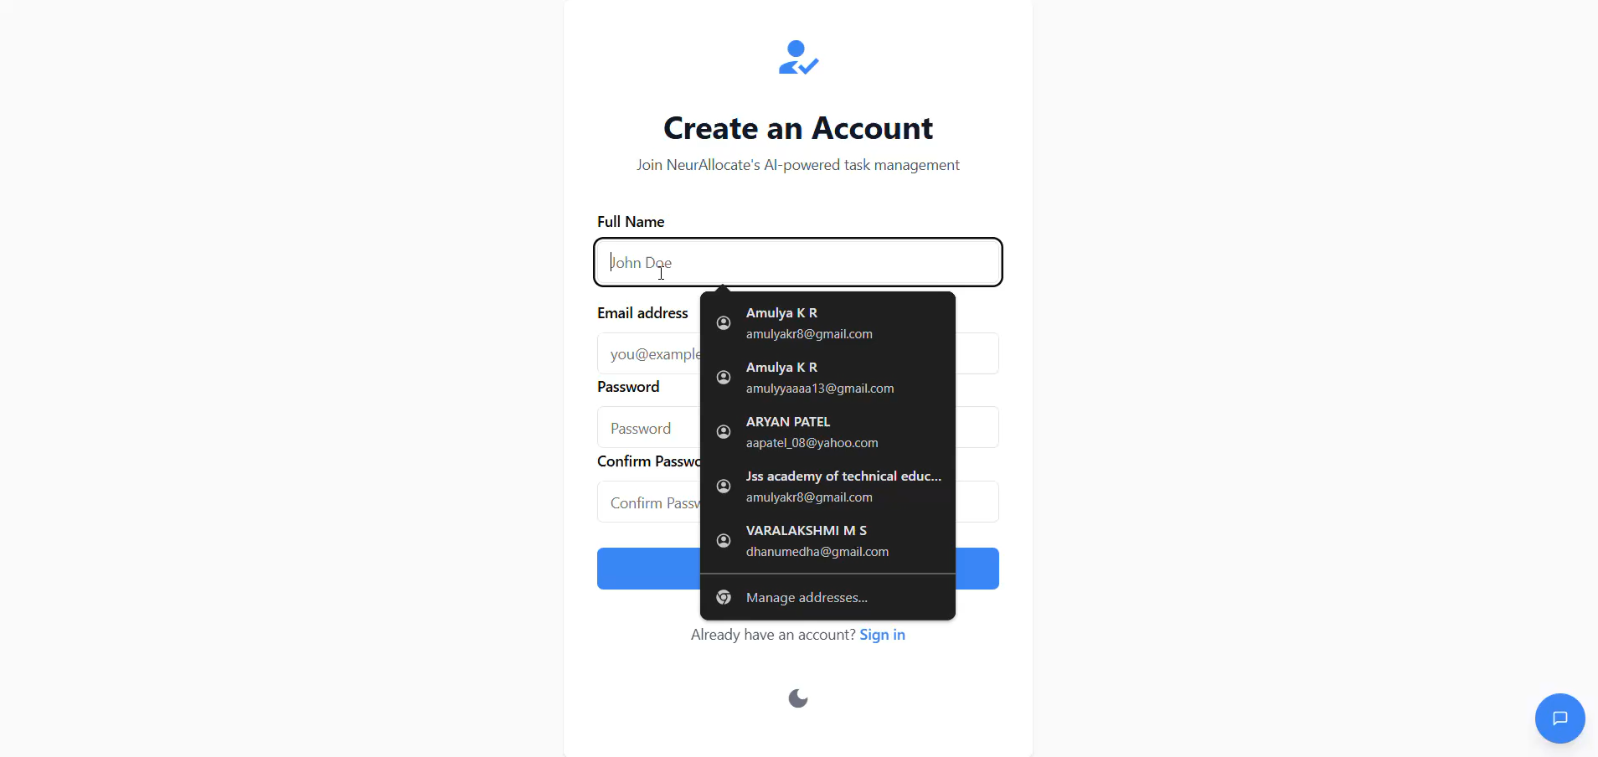
DEMO VIDEO PPT

